Slide 1
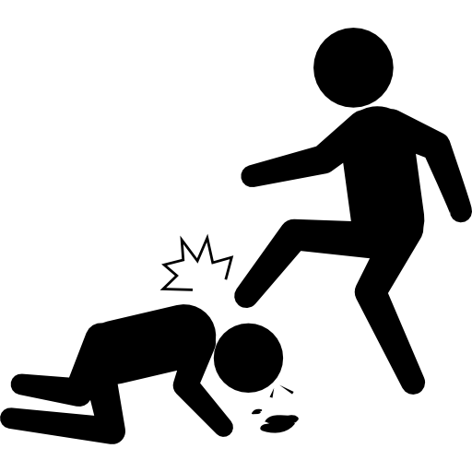

Tracking Violent Extremist Occurrences and Responding to them
Ndubuisi Nwokolo, PhD
Managing Partner, Nextier

Slide 2
Background
Nigeria is currently dealing with widespread violence
Every region in Nigeria currently experiences one form of violence or the other
Religion, political beliefs, ethnicity, and economic ideology exacerbate these violent trajectories.
For Nigeria as a multi-cultural, multi-religious, multi-ethnic with diverse political development, violent extremism easily thrives.

Slide 3
Violent Conflict Data: Regional Overview(source: Nextier violent Data base)

Slide 4
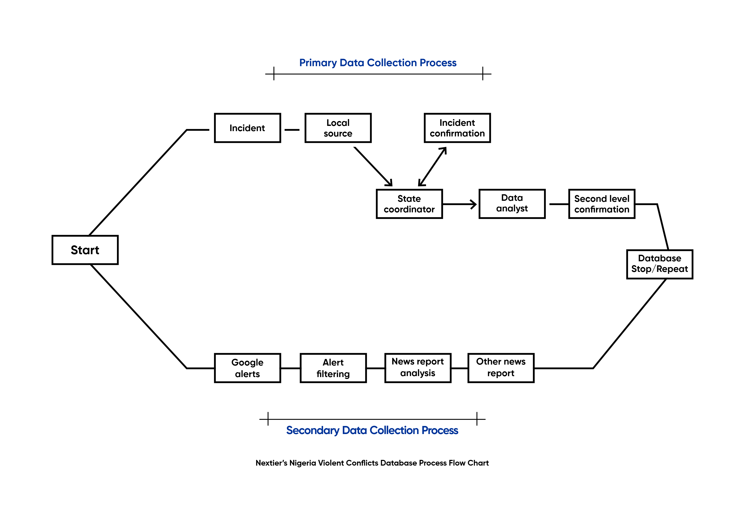
Tracking Violent Extremist Occurrences- Nextier

Slide 5
How to track from State and non-state perspectives
01
State Security Agencies
04
CSOs/NGOs/Schools/
02
03
Religious bodies
Local communities
Non-Security State institutions
05
Traditional authorities
06

Slide 6
How to respond to violent extremism
Education
Scaling up governance
Employment and livelihood
Developing P/CVE programmes
Military actions

